Slide 1

How do you get through
stress and worry?
OK You is looking for your
creative ideas!
ok
challenge
20
25
Open to all high school students!

Slide 2
what’s this all about?
OK You is a nonprofit with a mission to inspire more people to “create their own OK.”
Think of OKness as that feeling of inner peace you get when you’re feeling strong, calm and connected to your best self.
OK You believes we all have it in us to create
that feeling for ourselves, and that
high school students have the wisdom and imagination to create more OKness in the world.

Slide 3




3 reasons to participate:
25+ finalists will have
their ideas featured in
the OK Challenge e-book!
Support wellness!
Spread OKness!
Win cash
prizes!
1st place: $350
2nd place: $250
3rd place: $150

Slide 4
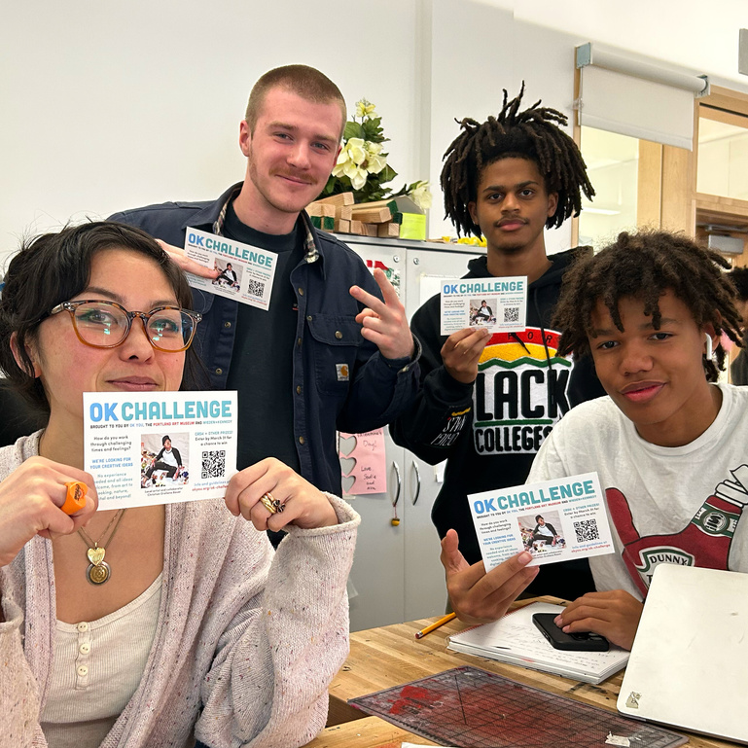
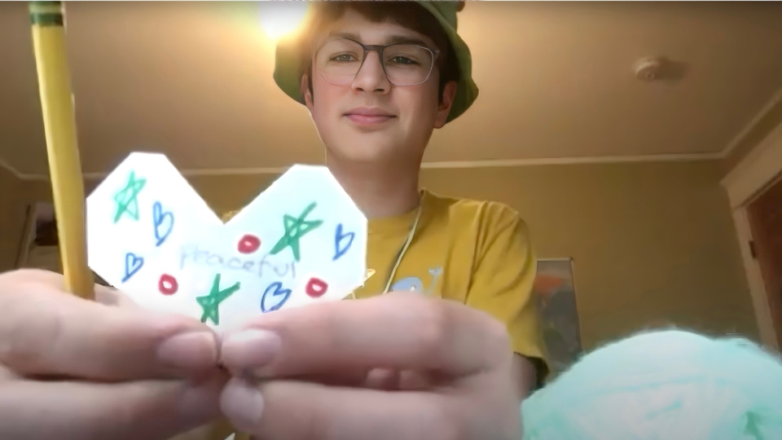

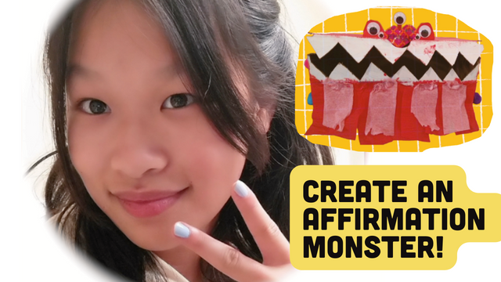


how it works:
Work on your own
or in a team
(you can submit up to 2 ideas)
Come up with an activity that can help others when
they’re stressed or worried
No art experience needed! OK You is looking for new ideas!
Enter your idea by
midnight, March 31!

Slide 5
View How-To Video

Slide 6


ok
challenge
20
25
Worksheet
STEP 1
Alone
Decide if you are going to work on your own, in a team, or both. (Cash prizes are split evenly among team members)
You can submit up to 2 ideas—
on your own, in a team,
or a combination.
Team
Both

Slide 7


TIP 1:
Be yourself! If you like and believe in your
idea, so will we!
STEP 2
Make a list of all the
things that help you get through stress or worry.
Like:
Going for walks
Talking with friends
Listening to music
Drawing
Baking
TIP 2:
Think about some things you liked to do when you were younger. What kinds of activities made you feel happy and calm?

Slide 8

TIP 3:
What calming activity could you do in a car? On a sidewalk?
At a school desk?
In a hallway?
STEP 3
Make a list of new ideas that you’ve thought about trying, or that you think would help you or a friend get through stress
and worry

Slide 9


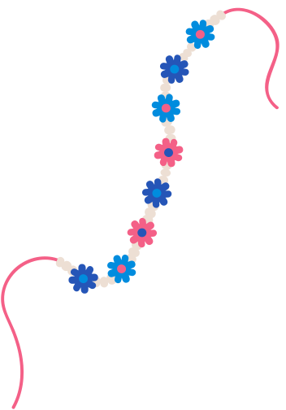
TIP 4:
Look around your room, go for a walk, stroll through a thrift store, dig through the recycling bin. Ask yourself:
How could this object be used in a project that helps people stay connected to their “OK selves”?
STEP 4
Using your list of ideas and gathered objects (see TIP 4) as inspiration, dream up some specific activities. If you like going on walks, what is a creative activity that you could do on a walk? If you’re working with an object (cereal box, playing cards, an old
T-shirt, etc.), how could your object be used in a project
that helps with stress
and worry?

Slide 10

Name of project or activity
How your activity can help with stress or worry
STEP 5
List of supplies needed for your activity
Express your idea on an
8 1/2 x 11" piece of paper or digital document. You can face your paper in either direction, but please only use one side. Be sure to include everything on
the checklist below.
Instructions with images (drawings, photos, collage, or other visual)
A short message that encourages others to try your activity
TIP 5:
Think about how to share your activity in a way
that would get others
excited to try it.

Slide 11
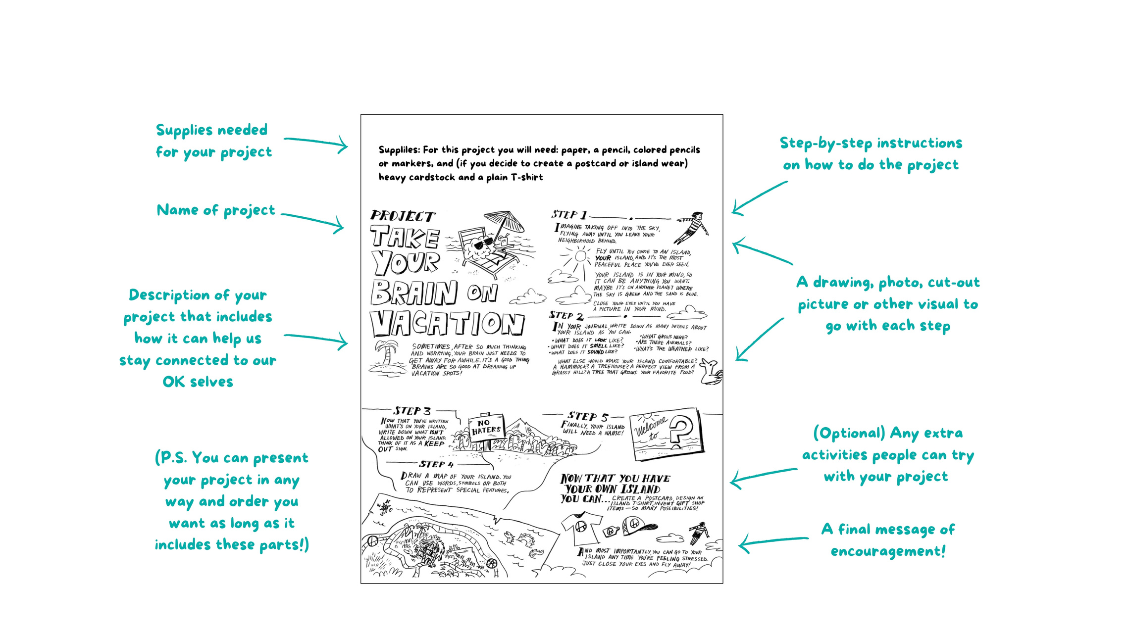
Your project doesn’t need to have as many words as these examples, and you can use any
kind of visuals you want: drawings, photos, cut-out pictures, fabric... it’s up to you!
Project
Example
1

Slide 12
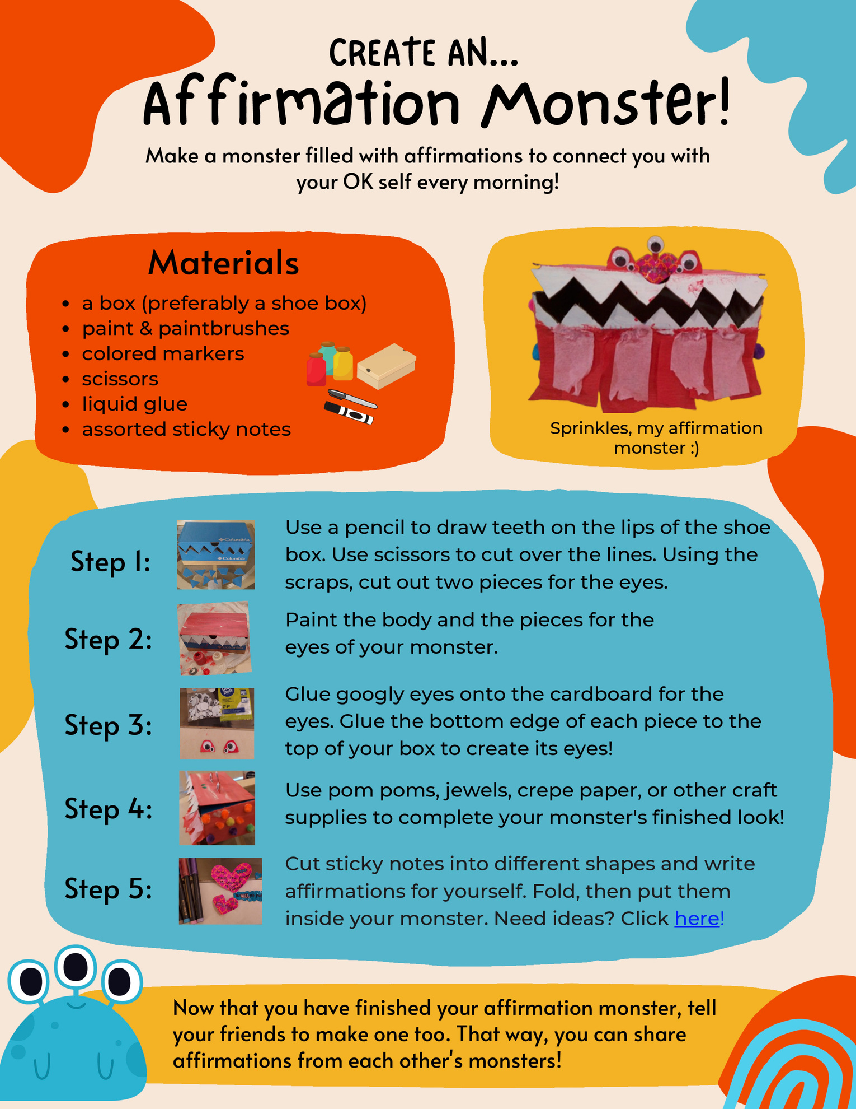
Project
Example
2

Slide 13
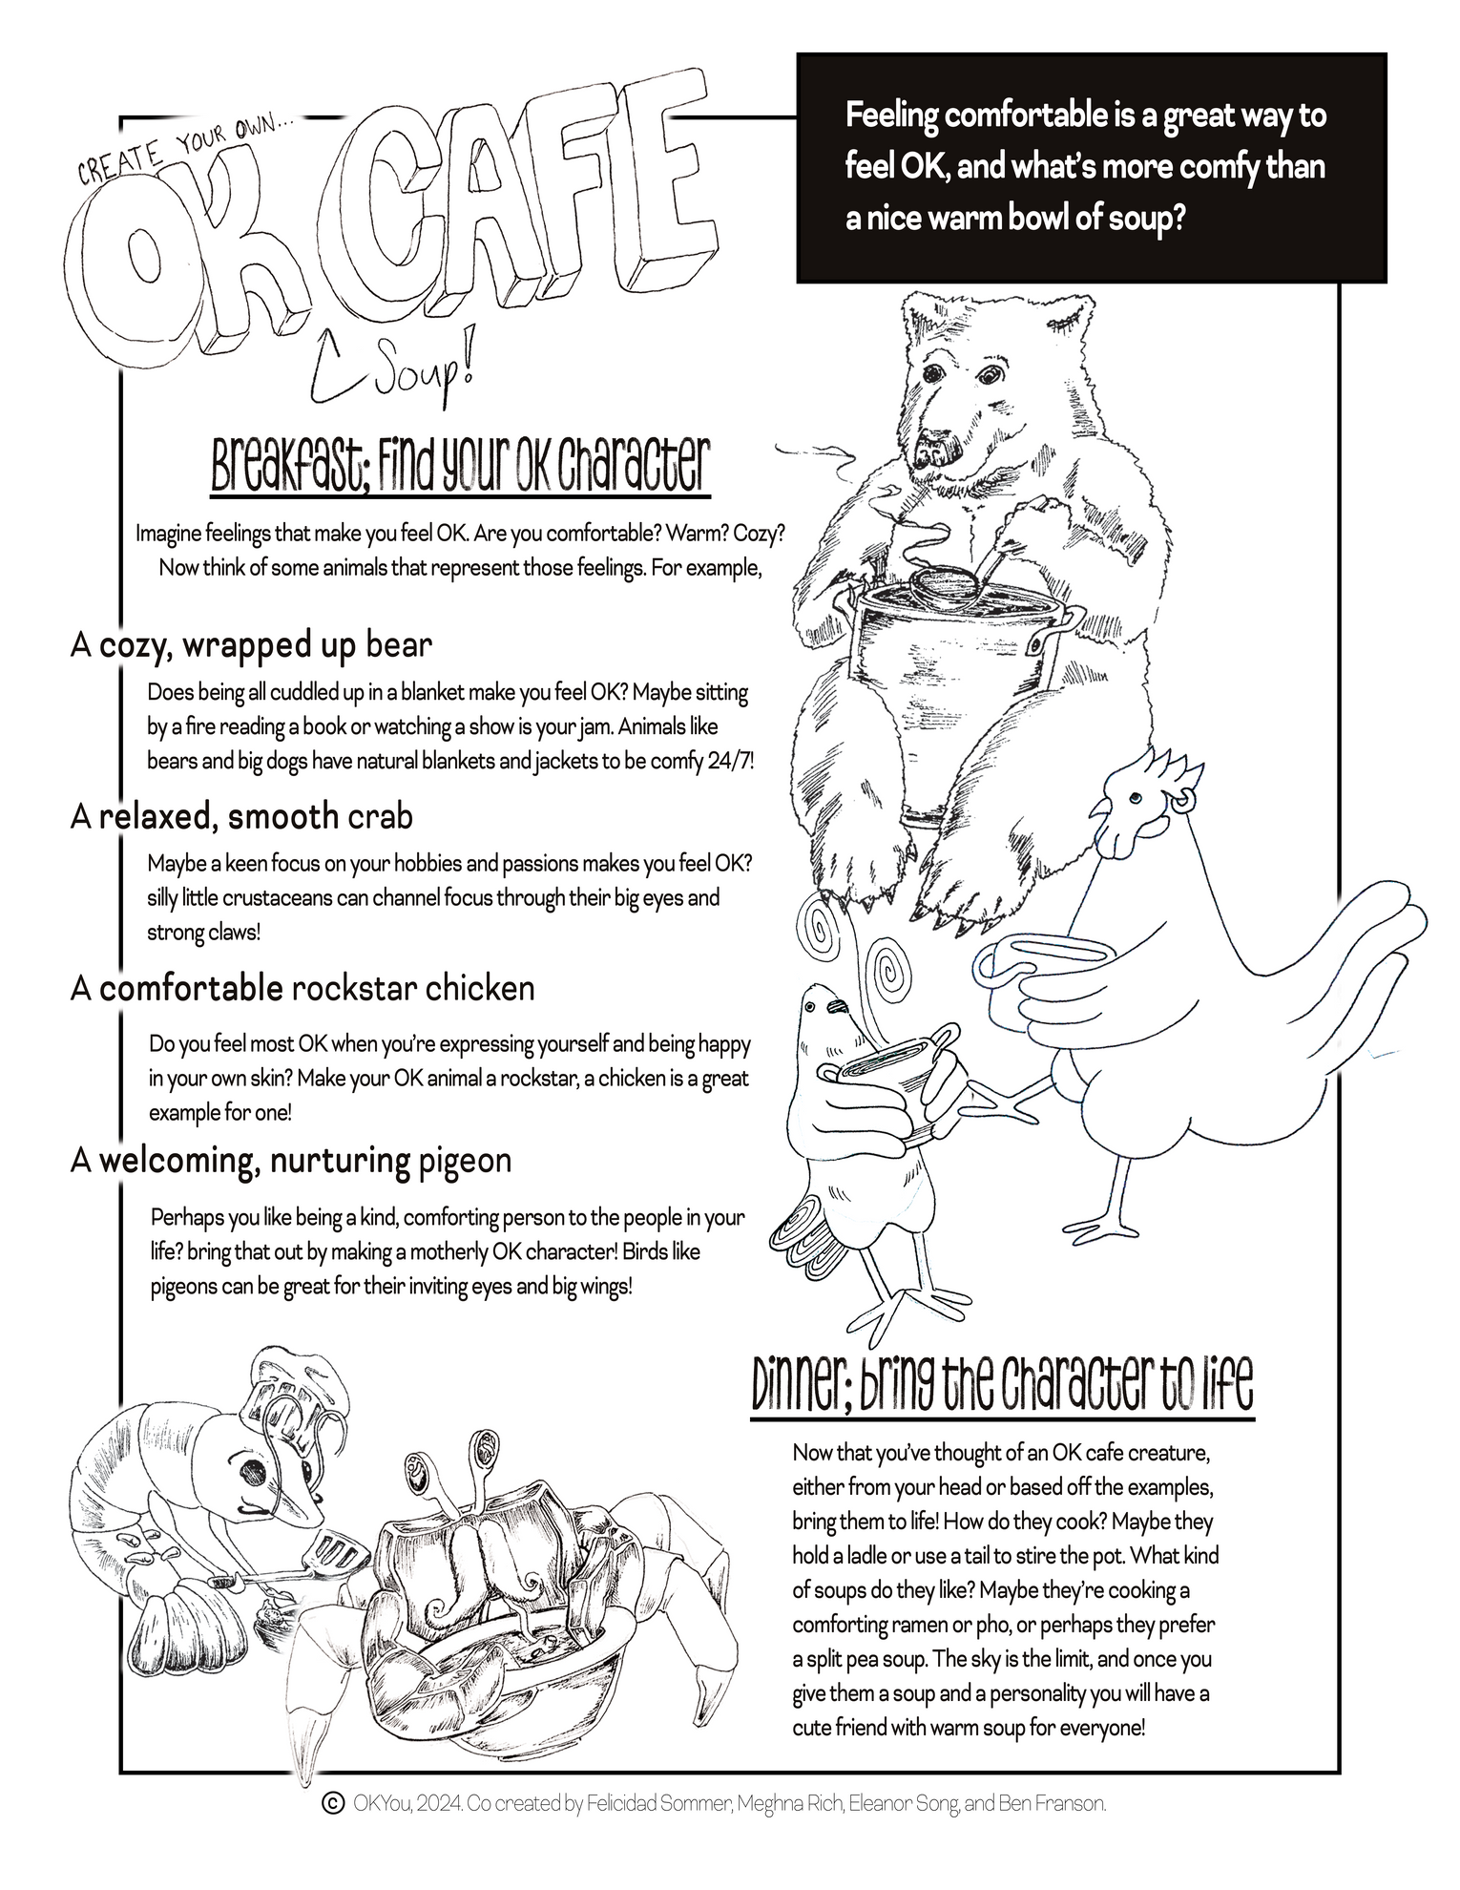
Project
Example
3
This project was created by a team. Each member came up with a different character.

Slide 14
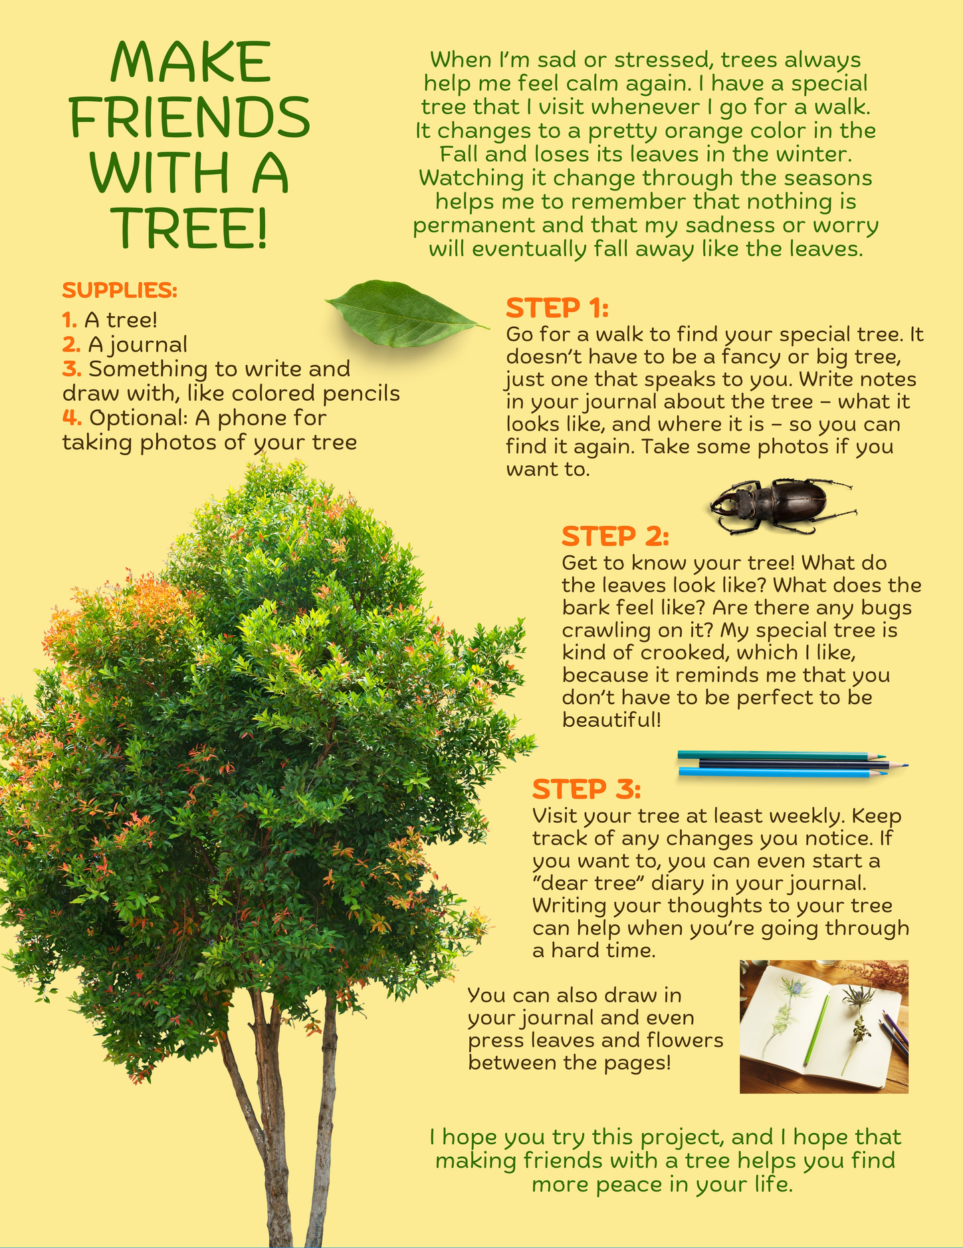
Project
Example
4

Slide 15
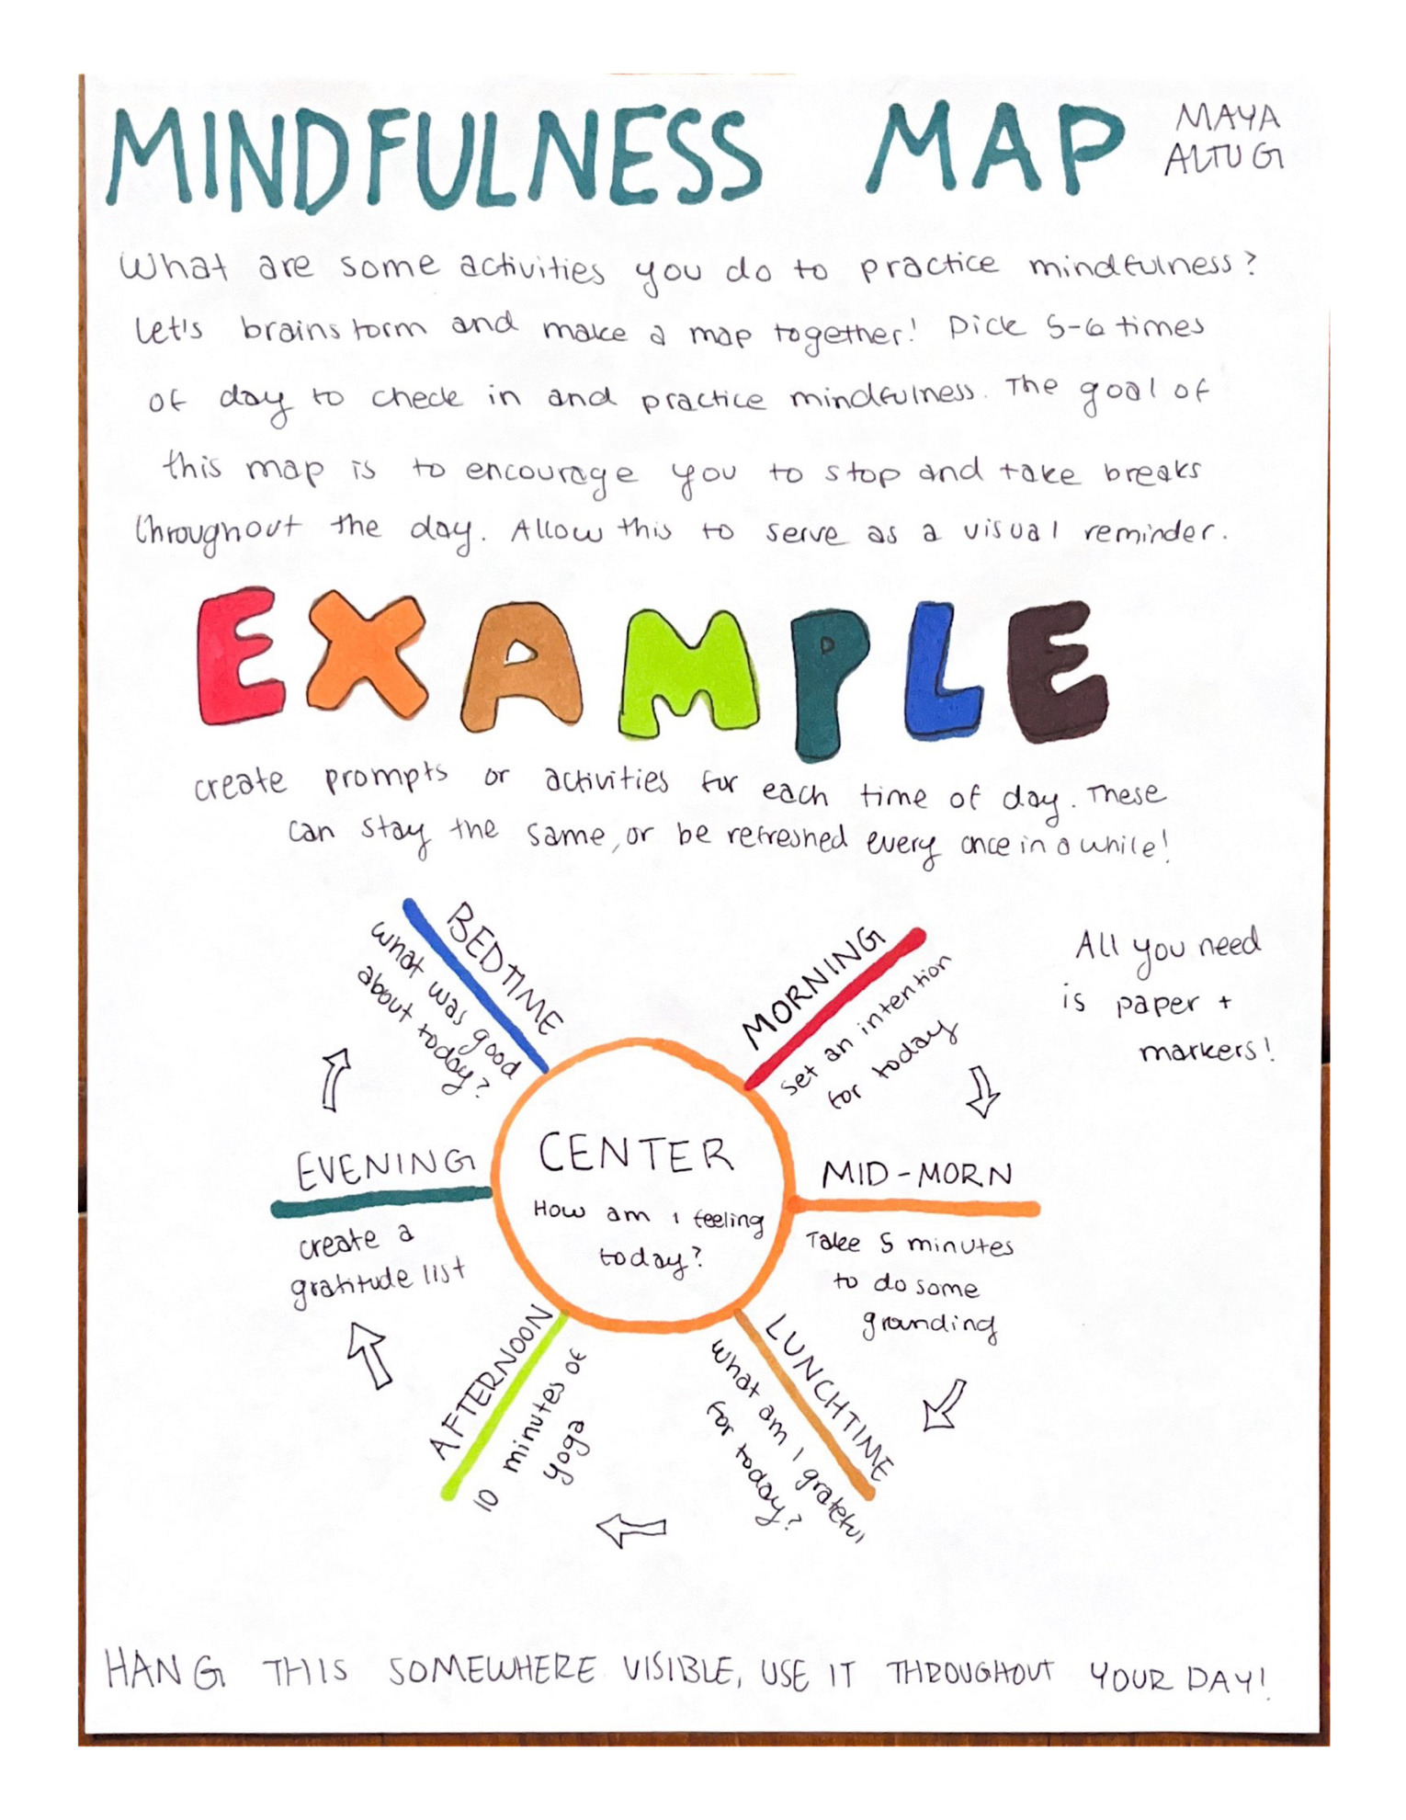
Project
Example
5

Slide 16



For more info
and guidelines:
To submit
your idea:
Enter by March 31!
okyou.org/ok-challenge-2025
bit.ly/2025OKSubmission

